Slide 1
Presentation
Problem statement and understanding of project customer_retention.

Slide 2
Problem statement
Customer satisfaction has emerged as one of the most important factors that guarantee the success of online store;
; it has been posited as a key stimulant of purchase, repurchase intentions and customer loyalty.
Five major factors that contributed to the success of an e-commerce store have been identified as: service quality, system quality, information quality, trust and net benefit
The research furthermore investigated the factors that influence the online customers repeat purchase intention.
The combination of both utilitarian value and hedonistic values are needed to affect the repeat purchase intention (loyalty) positively

Slide 3
Steps included for EDA
Firstly we have to upload the dataset to jupyter notebook.
Then we have to check the nulls and unique values.
As we can see in our data set we have string and int values in columns we have to set the columns before forwarding to analysis part that is also known as preprocessing of data.
Now we will analysis data through visualization.

Slide 4
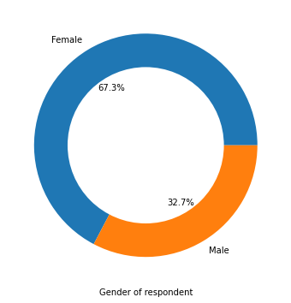
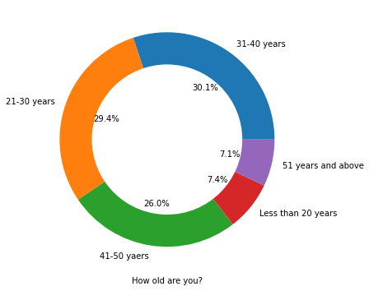
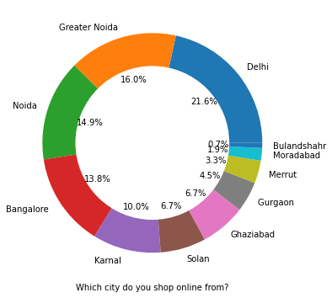
Personal information

Slide 5
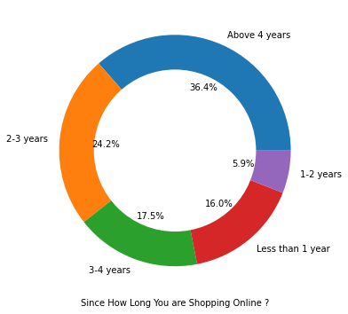
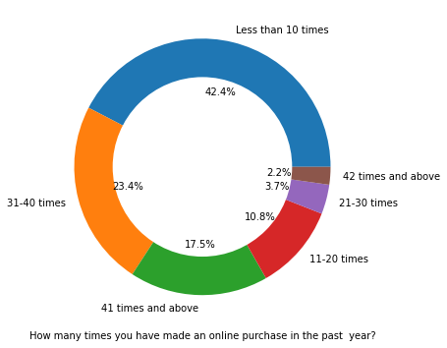

Slide 6
There is double the number of women than men who have taken this survey. -Most of the people are in their 30's followed by 20's, teenagers and senior citizen are the least in number.
Most of the people belong from Delhi, Noida and Bangalore.
Most of the people shopping online have been shopping from a long time.
Majority of people shop online 10 times a year.

Slide 7
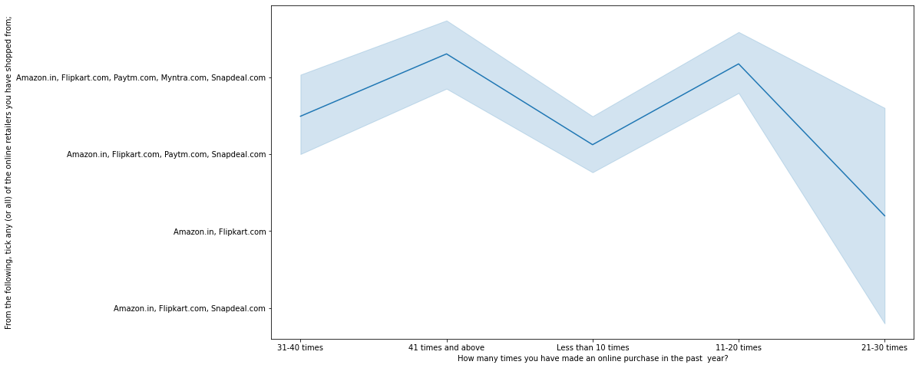
Analysis on the basis of Various following factors Intention of Repeat purchase:

Slide 8
Heavy shoppers who shop more than 41 times a year shop from all the online brands, some of the people who shop for 32-40 and less than 10 times a year seem to exclude Myntra. People shop from Amazon and Flipkart whatever be the case.

Slide 9
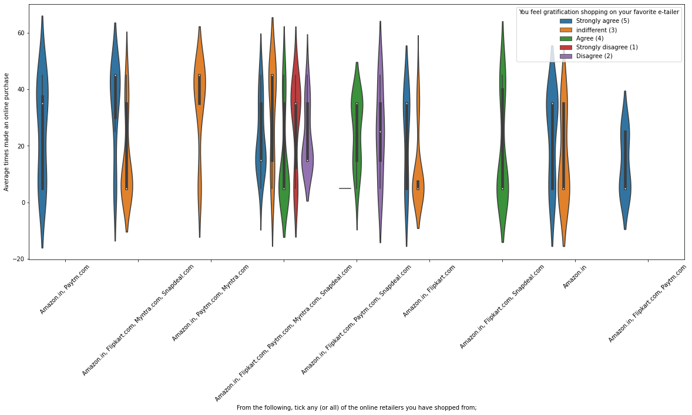
Almost all the people who have shopped from amazon, flipkart and paytm are satisfied. People who shop from a more number of online brands dosen’t seem to be satisfied.

Slide 10
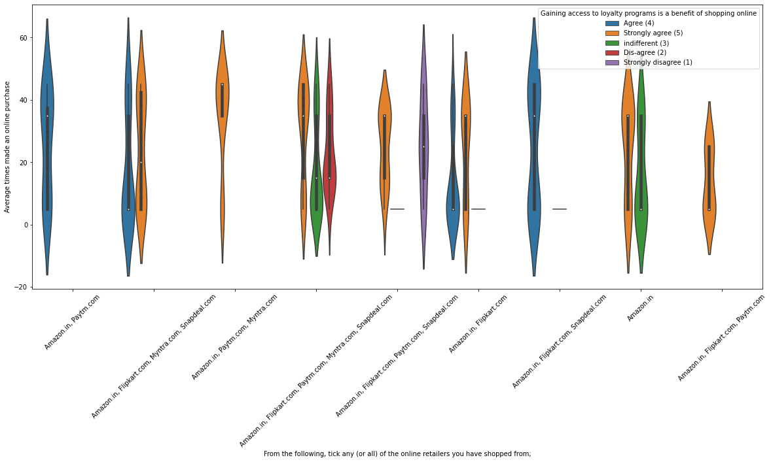
People shopping from amazon and paytm are getting benefits from the loyalty points, flipkart and snapdeal also seem to give such benefits but people who shop from almost everywhere disagree with this statement too.

Slide 11
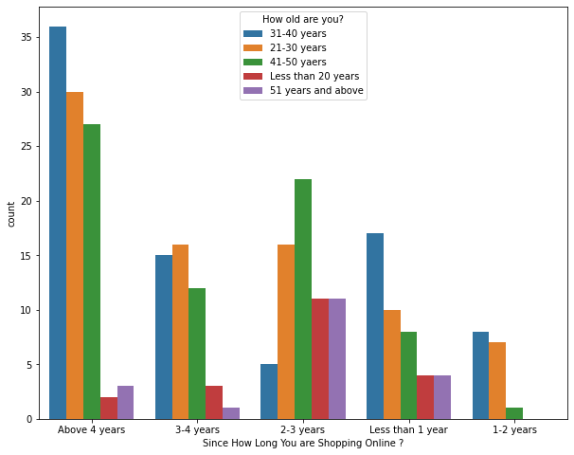
Online Retailing:
Highest number of people have been shopping online for above 4 years except for the age group below 20 years and above 50 years. People who are shopping online for 1-2 years does not include teenagers and elder people.

Slide 12
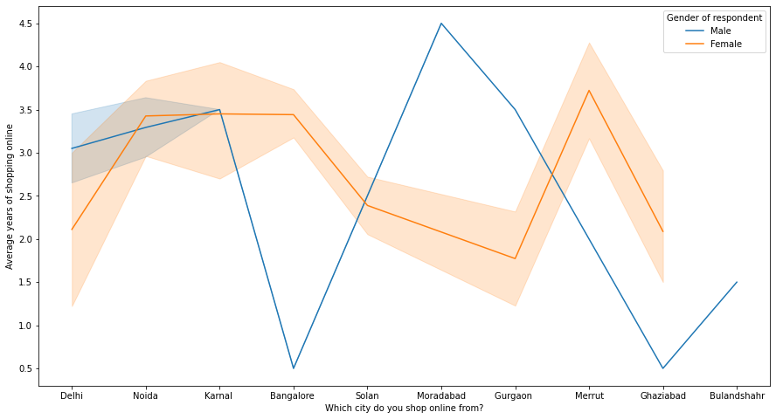
In lines, we can see that density of female customers is more than male. Men living in Bangalore and Ghaziabad shop have shopped online for less than 1 year. Highest number of men shopping online belong from Delhi and Noida, while men from Moradabad have been shopping online for the longest. Women from Meerut and Noida have shopped the longest.

Slide 13
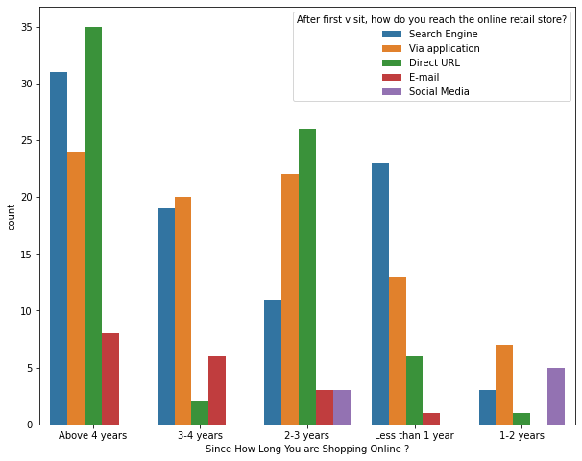
Even though people who are shopping online for more than 3 years don’t use the application rather use search engine and direct urls in large number which indicates that online brands should update all their platforms rather than just application.

Slide 14
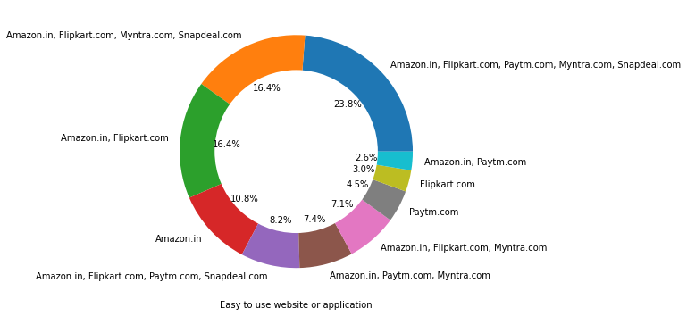
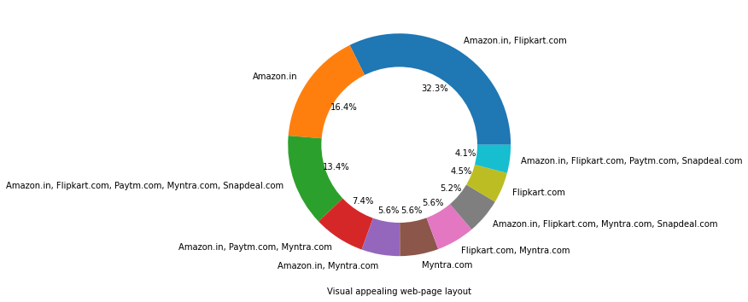
Brand image

Slide 15
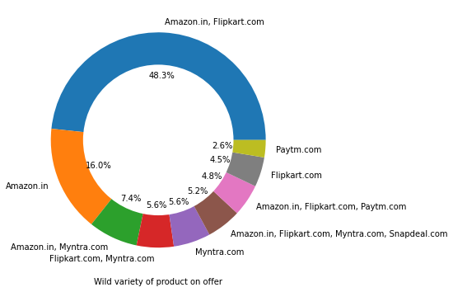
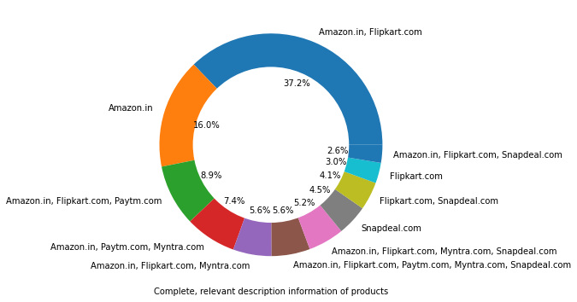

Slide 16
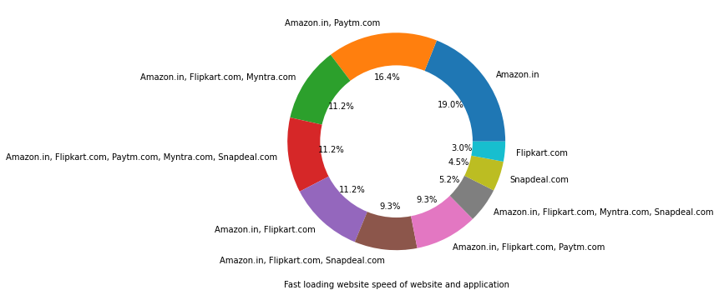
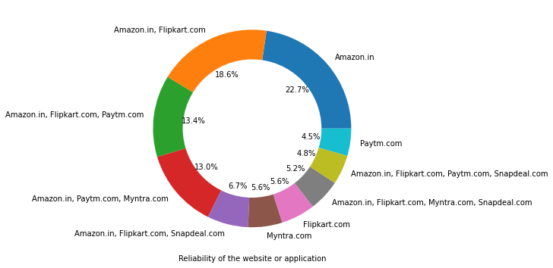

Slide 17
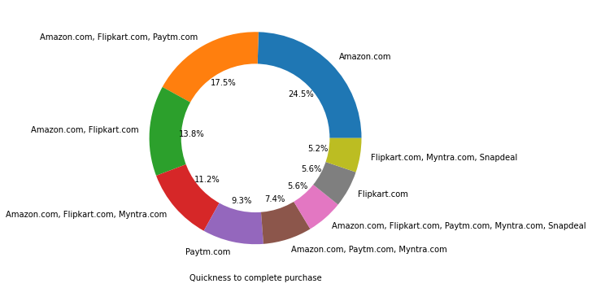
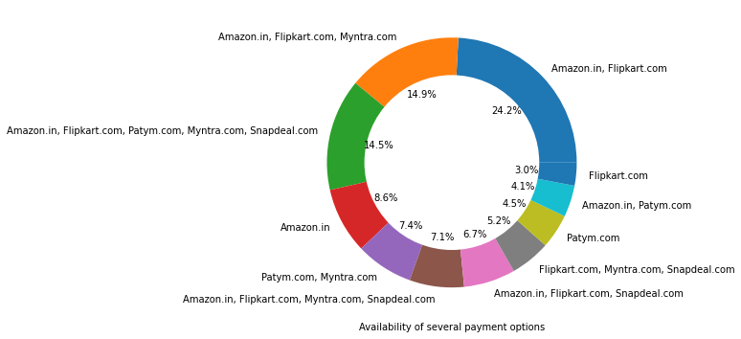

Slide 18
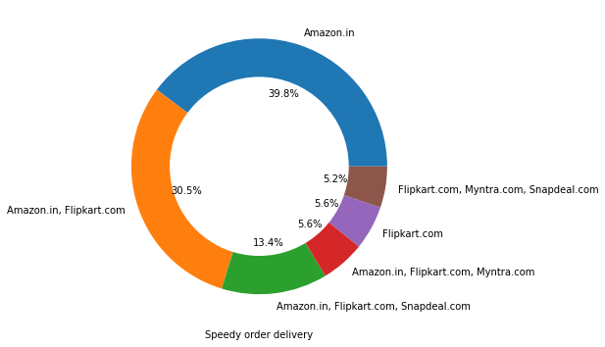
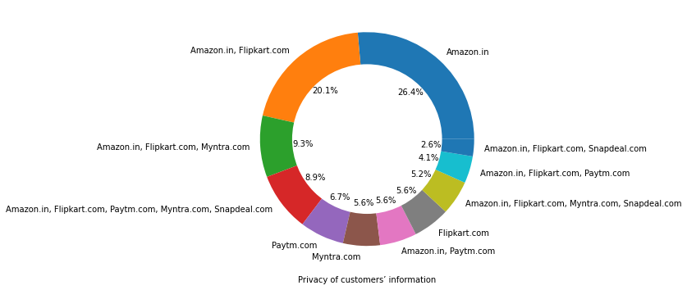

Slide 19
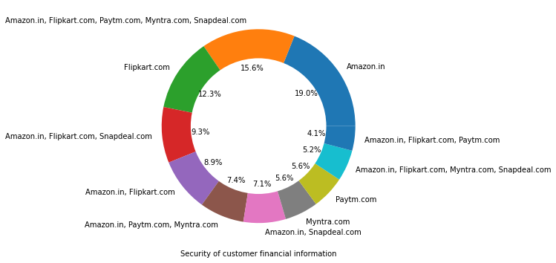
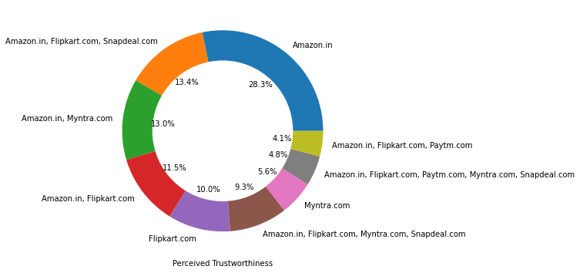

Slide 20
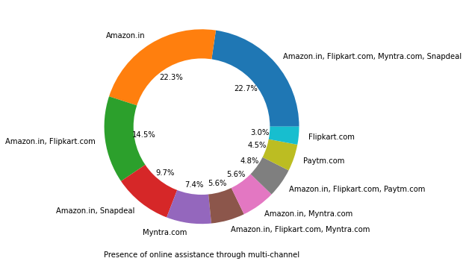
Amazon, Flipkart have been had the highest votes for having all the positive points and have maintained a very good brand image followed by paytm and the myntra.

Slide 21
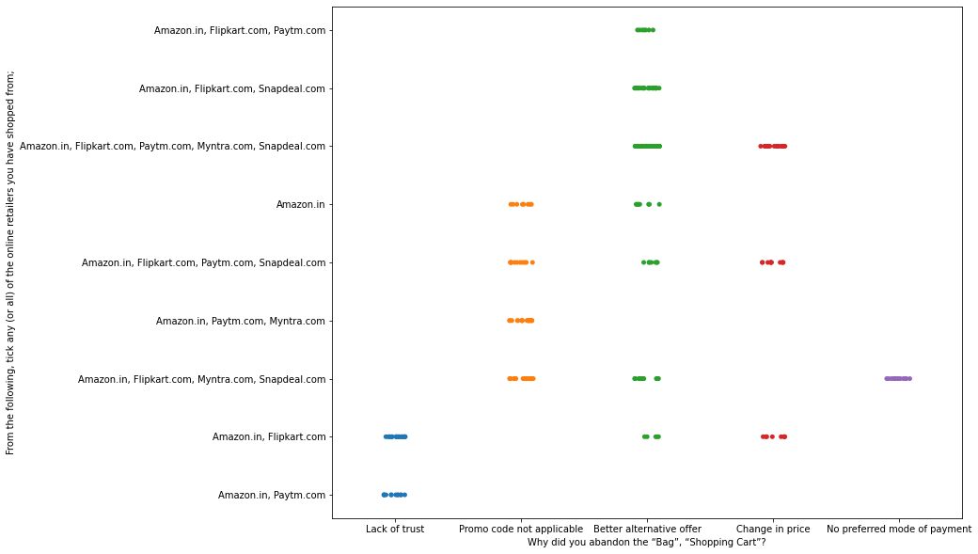
We can clearly see that most of the time people abandon the bag is because they get a better alternative offer or promo code not applicable. There is also lack of trust seen in amazon, flipkart and paytm by some people.

Slide 22
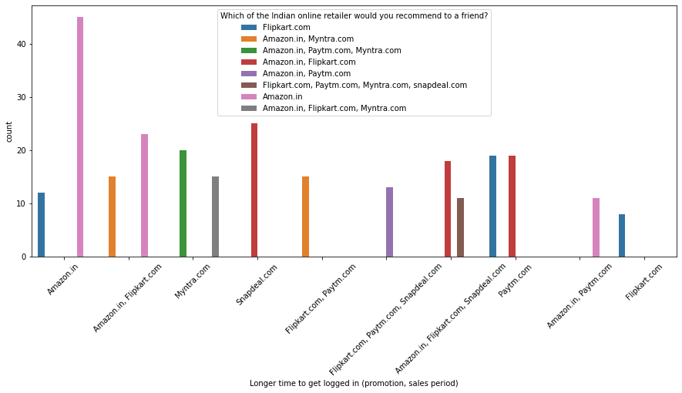
Loyalty

Slide 23
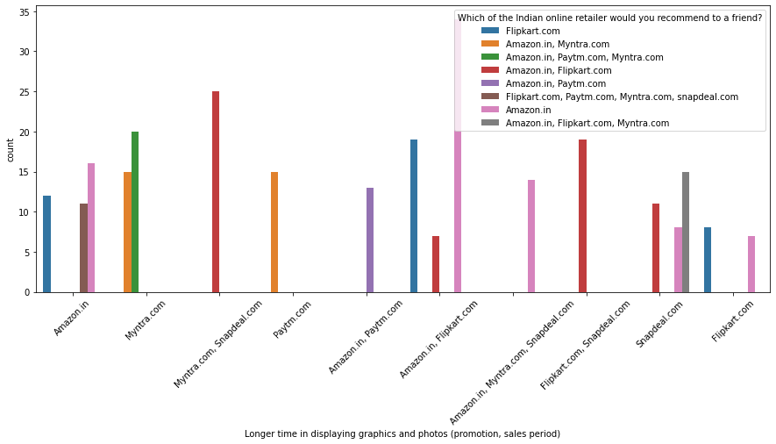
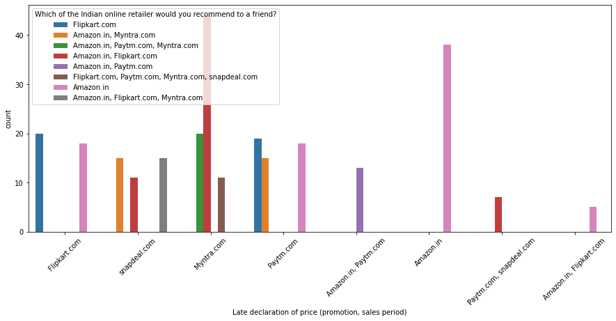

Slide 24
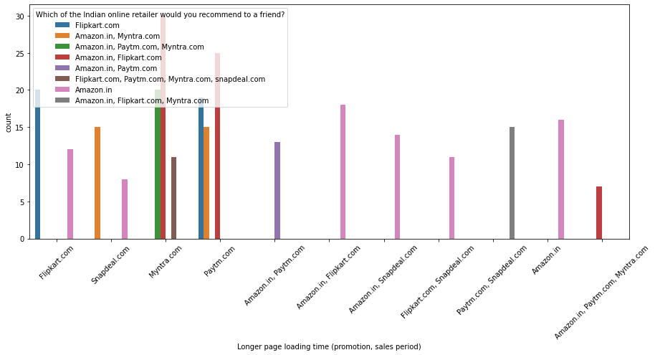
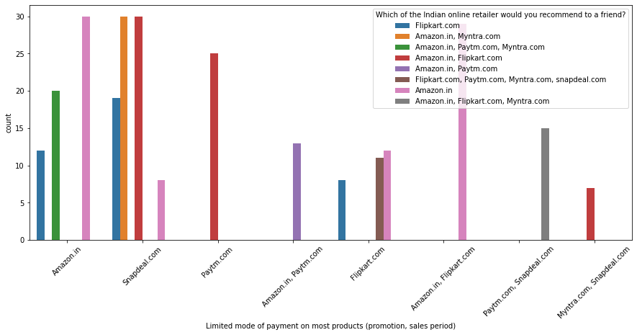

Slide 25
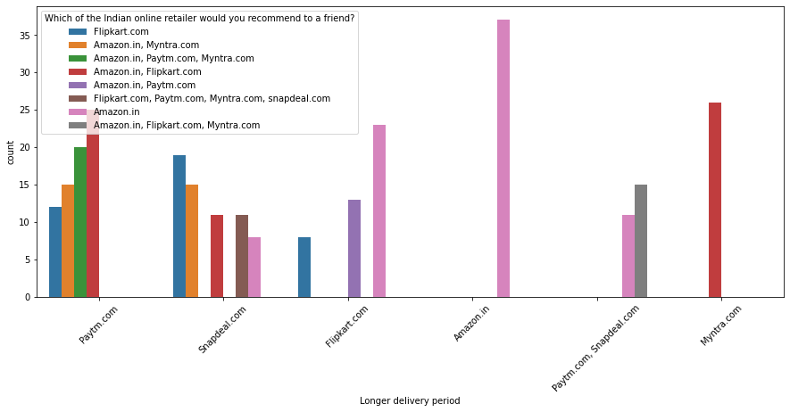
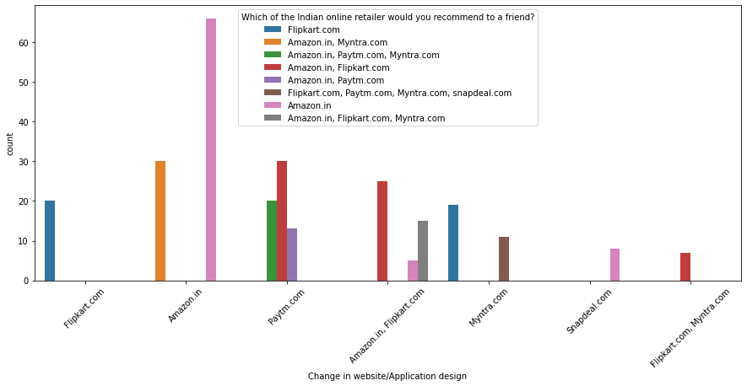

Slide 26
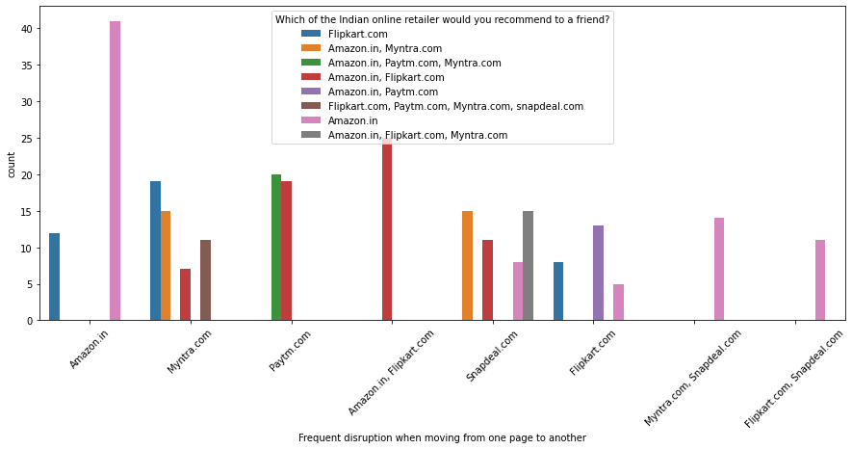
Customers seems to be more loyal to amazon, flipkart and paytm as even though many of them have given negative remarks about them still they would recommend these platforms to their friends.

Slide 27
Result:
The results of this study suggest following outputs which might be useful for online websites to extend their business:
The cost of the product, the reliability of the online company and the return policies all play an equally important role in deciding the buying behaviour of online customers.
The cost is an important factor as it was the basic criteria used by online retailers to attract customers.
The reliability of the online company is also important, as it is even required in offline retail. It is important because customers are paying online, so they need to be sure of security of the online transaction.
The return policies are important because in online retail customer does not get to feel the product. Thus, he wants to be sure that it will be possible to return the product if he does not like it in real.
Whereas, the logistics factor, which included Cash on delivery option, One day delivery and the quality of packaging plays a secondary role in this process though these are Must-be-quality. This is so because these all does not interfere with the real product and people believe that this is the basic value that online websites provide.
All the websites were not equally preferred by online customers. Amazon was the most preferred followed by Flipkart.
This can be explained easily by previous result that we got. These two companies are most trusted in the industry and hence, have a huge reliability.
Also, the sellers listed on these websites are generally from Tier 1 cities as compared to Snapdeal and PayTM which have more sellers from tier 2 and 3 cities.
Also, these websites have the most lenient return policies as compared to others and also the time required to process a return is low for these.

